Slide 1
How to Access Student’s Destiny Barcodes
How to Access Destiny Barcodes without a Librarian
By Joseph Yune

Slide 2
What you need:
Access to the internet via browser
We recommend Chrome browser for this purpose
LAUSD Single Sign-On Username and Password
Your Username must be in the Destiny system

Slide 3
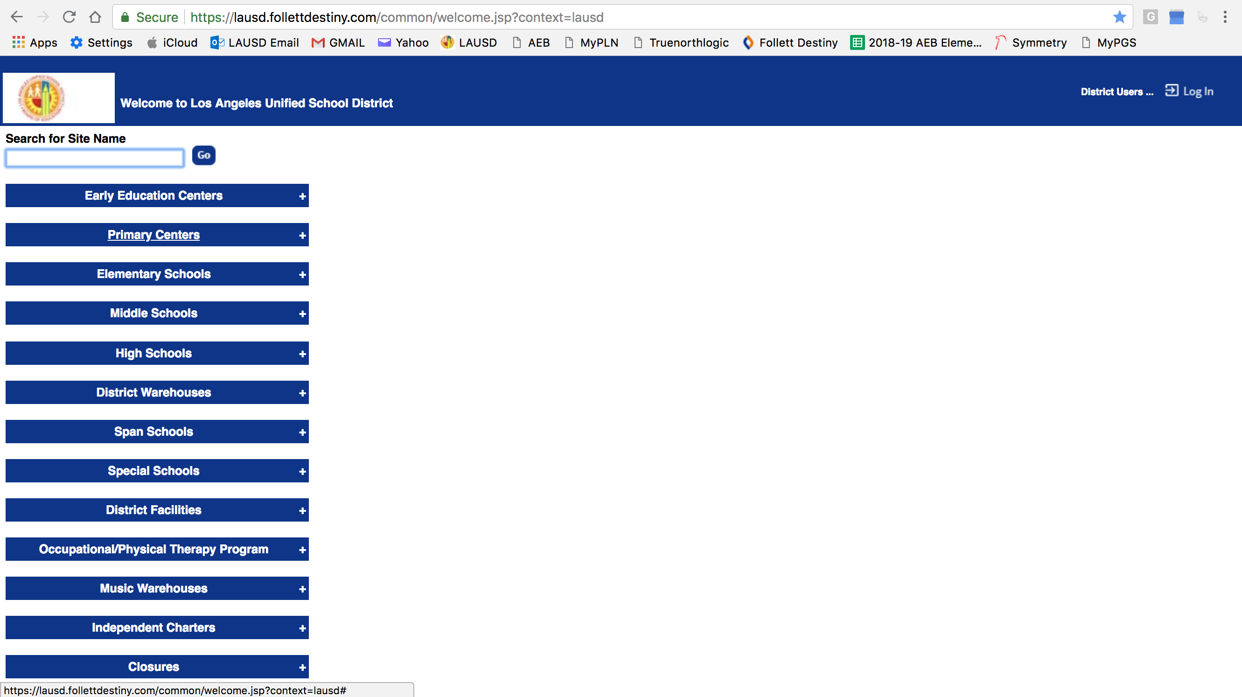
Destiny Website
Destiny Website: https://lausd.follettdestiny.com (Type in the URL and press Enter)
Double check the spelling!

Slide 4
Finding the School (Method 1)
Type in the name of the school and press “Go” – then click on your school name

Slide 5
Finding the School (Method 2)
Click “Elementary Schools” tab to search for Elementary Schools
Click “Middle Schools” tab to search for Middle Schools, etc.

Slide 6
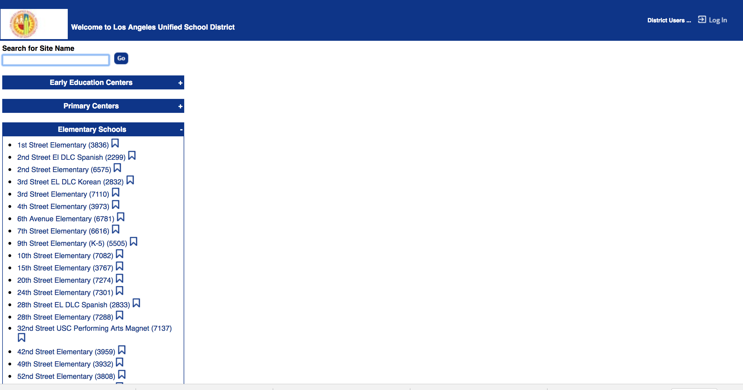
Search for Your School
Scroll down to search for your school

Slide 7
Choose Your School
Click on your school

Slide 8
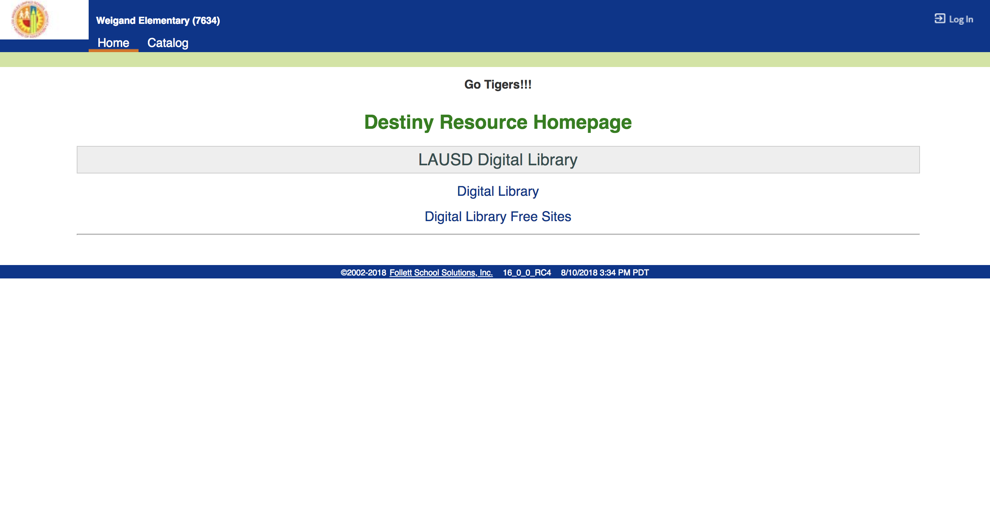
Logging In
On the top right corner, click on “Log In”

Slide 9
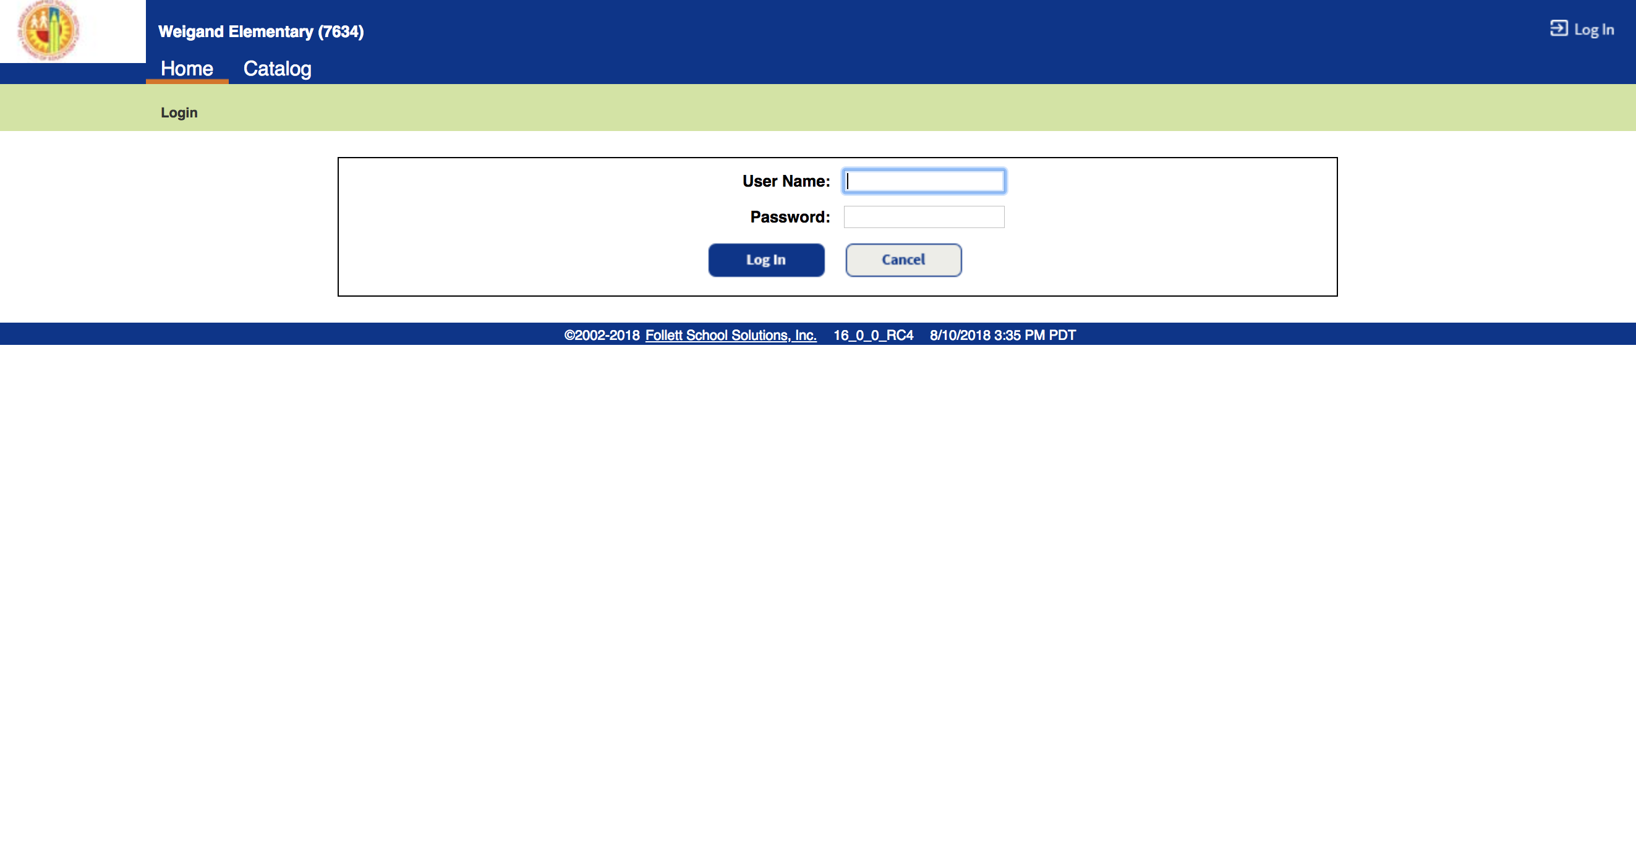
Logging In (Continued)
Type in LAUSD Username (Without @lausd.net) & Password, then click on “Log In”

Slide 10
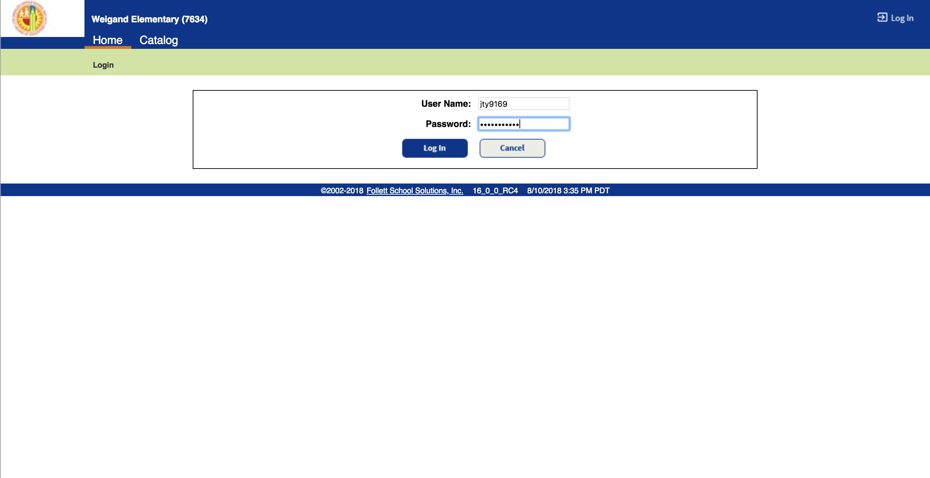
Logging In Sample
Type in LAUSD Username (Without @lausd.net) & Password, then click on “Log In”

Slide 11
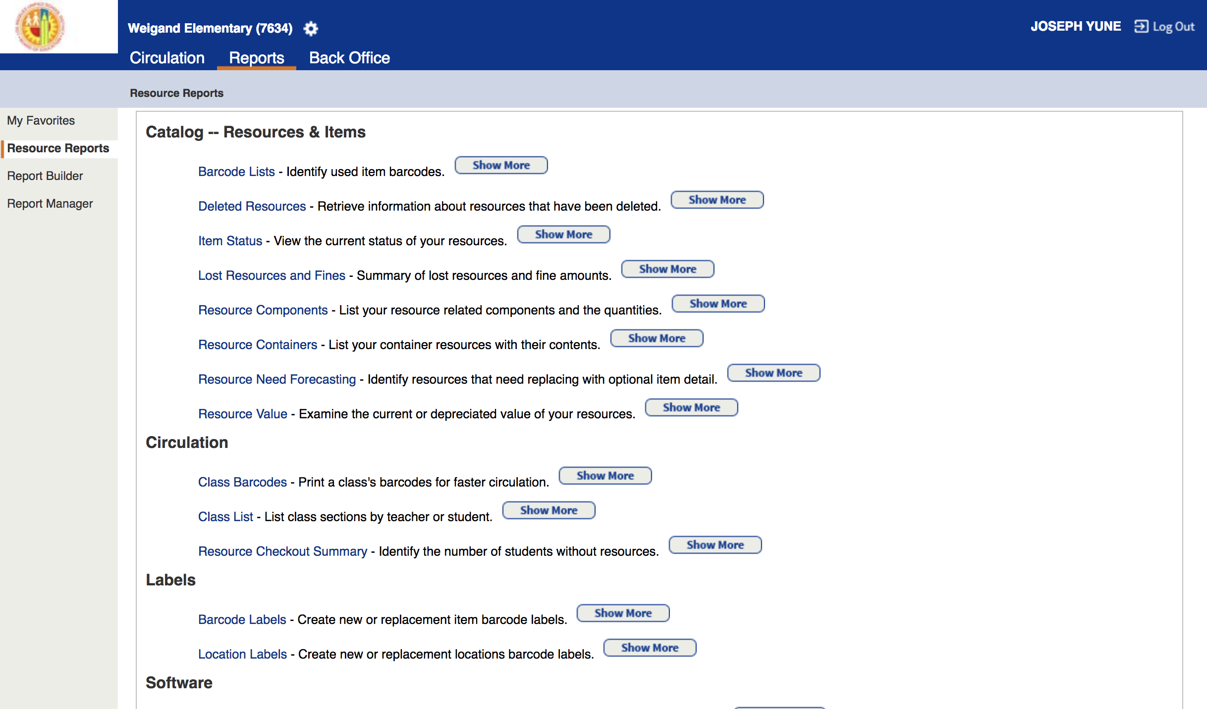
Accessing Class Barcodes
Click on “Reports,” then click on “Resource Reports”

Slide 12
Accessing Class Barcodes P.2
Under ”Circulation,” click on “Class Barcodes”

Slide 13
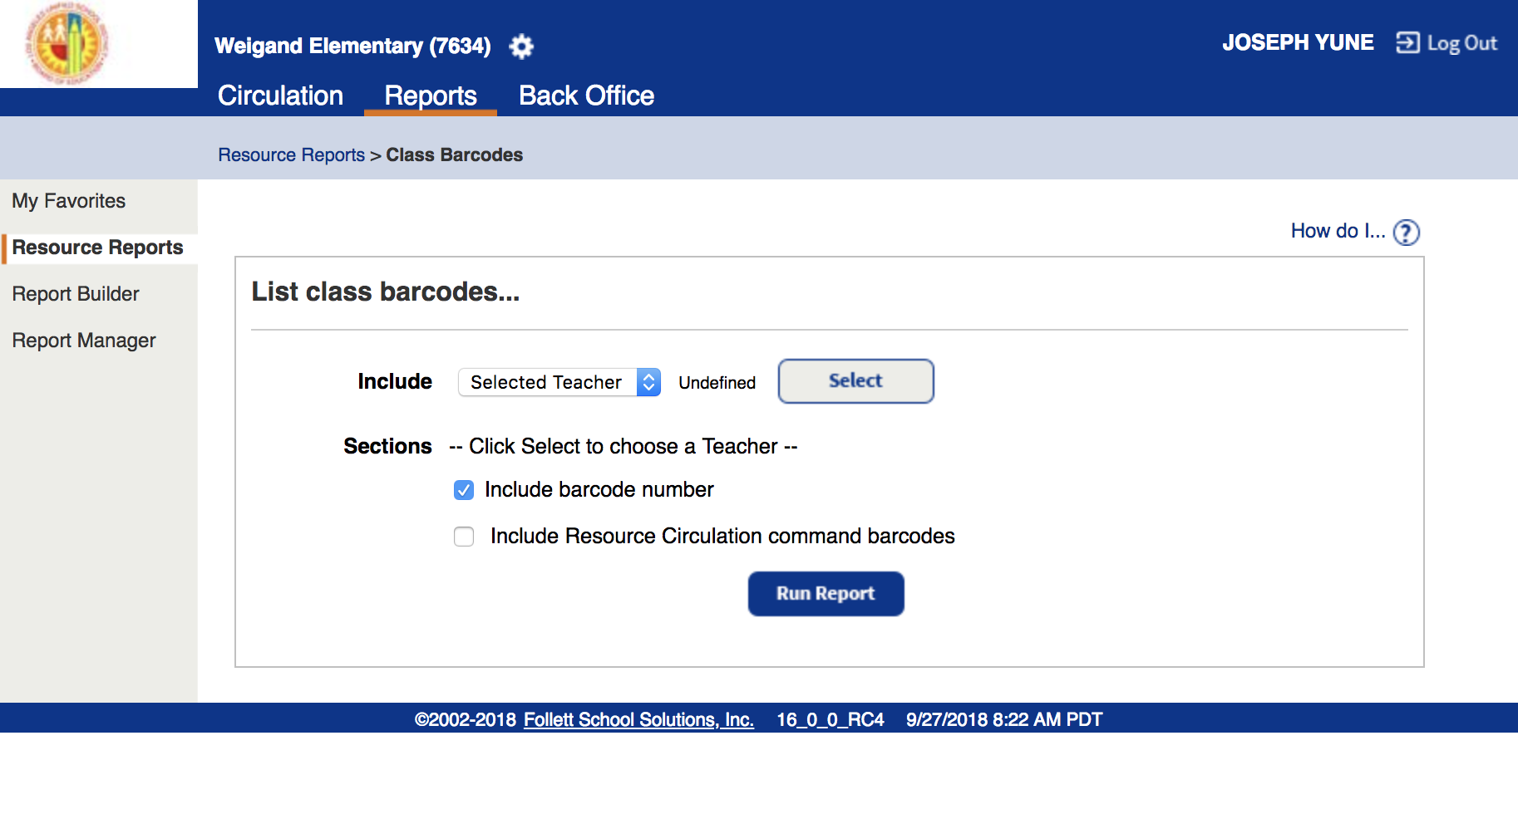
Accessing Class Barcodes P.3
Click on “Selected Teacher"

Slide 14
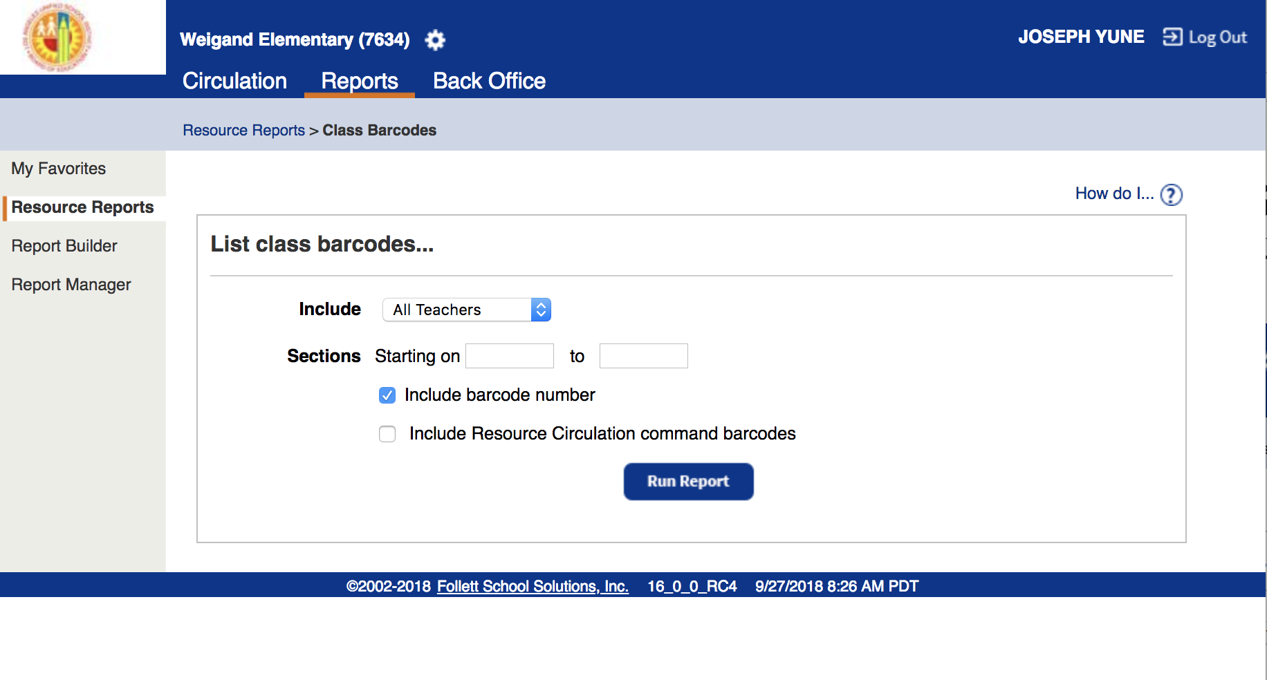
Accessing Class Barcodes P.4
Change it to “All Teachers” and leave both Sections, Starting on___ to___ blank

Slide 15
Accessing Class Barcodes P.5
Make sure the “Include barcode number” is checked
“Include Resource Circulation command barcodes” is Optional

Slide 16
Accessing Class Barcodes P.6
Click on “Run Report”

Slide 17
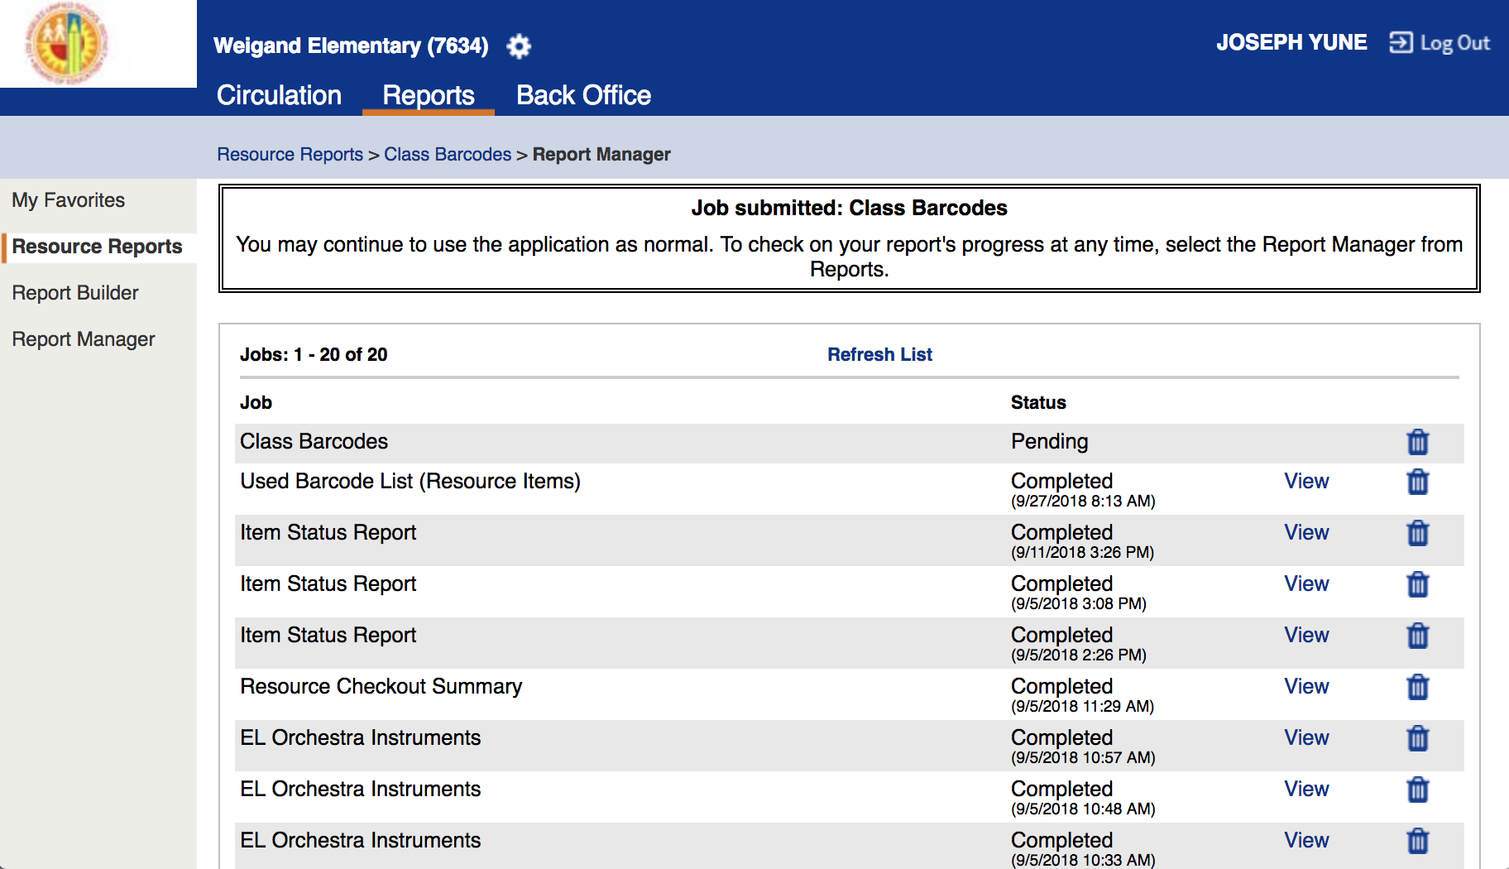
Accessing Class Barcodes P.7
“Pending” will appear

Slide 18
Accessing Class Barcodes P.8
Click on “Refresh List” until status shows “Completed” – You may need to click it several times

Slide 19
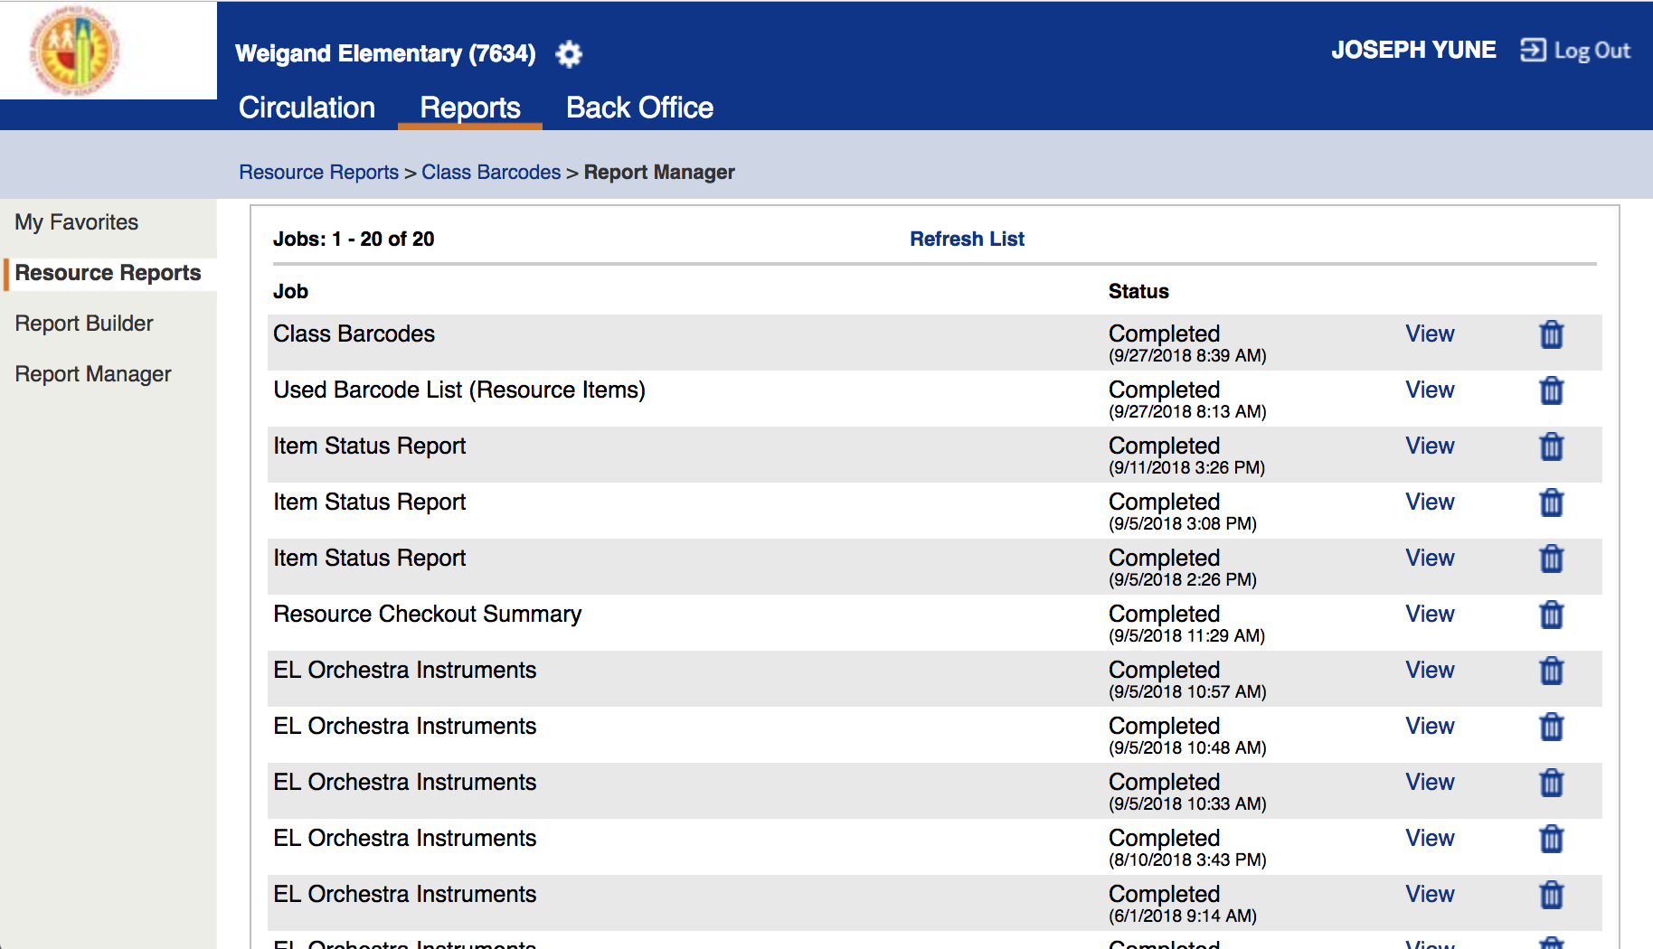
Accessing Class Barcodes P.9
“Completed” will appear, then click on “View”

Slide 20
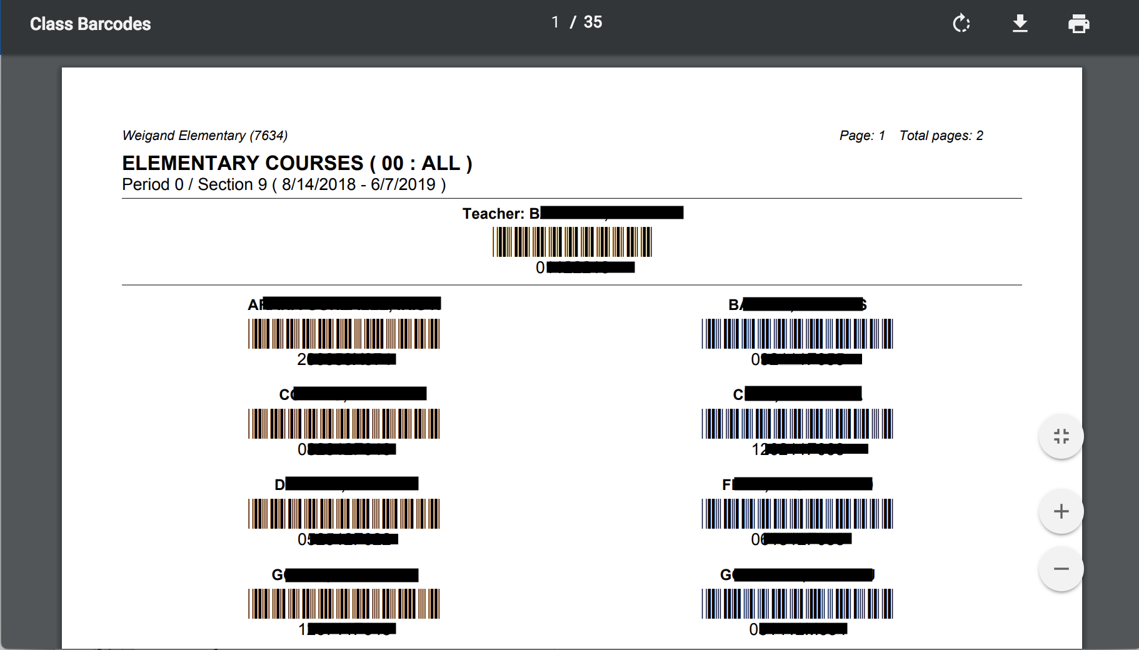
Accessing Class Barcodes P.10
You can choose to download (left) or print (right) the pages
*We recommend downloading, then printing (sometimes printing from the web browser does not work)

Slide 21
Logging Out
To Log Out from the Destiny page, click on “Log Out”

Slide 22
You Did It!
Congratulations!
You just learned how to access student’s barcodes without a librarian!
Questions:
Arts Education Branch: Joseph Yune (jty9169@lausd.net) 213-241-3368
ILTSS: Oscar Gonzalez (ogonza3@lausd.net ) 213-241-0465

